Slide 1
DATA WAREHOUSING
By
Syed Bakhtawar Shah Abid
Assistant Professor
Department of Computer Science
Data Warehousing

Slide 2
Data Warehouse
A collection of integrated subject oriented databases designed to supply the information required for decision making (William H. Inmon 1992).
Data Warehousing

Slide 3
Data Warehouse
Bill Inmon, who is considered to be the father of data warehousing states that
“A data warehouse is a subject-oriented, integrated, nonvolatile, validated, and time-variant collection of data in support of management’s decisions.”
Data Warehousing

Slide 4
Building Blocks of the Data Warehouse
Subject Oriented Data
Integrated Data
Time-Variant Data
Nonvolatile Data
Validated
Data Granularity
Data Warehousing

Slide 5
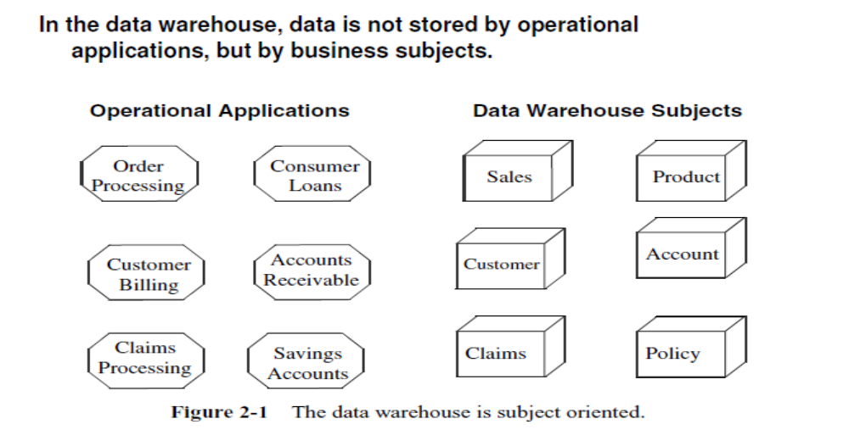
Subject Oriented Data
Data Warehousing

Slide 6
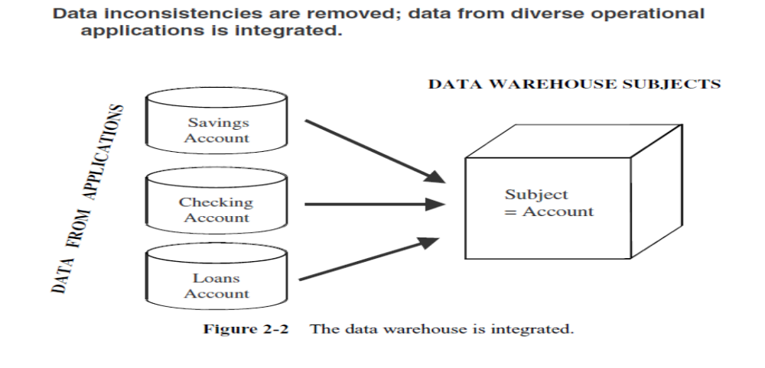
Integrated Data
Integrated:
  Data is extracted from many operational systems of the enterprise to provide an integrated view.
Data Warehousing

Slide 7
Time-Variant Data
For an operational system, the stored data contains the current values.
  In an accounts receivable system, the balance is the current outstanding balance in the customer’s account.
  In an order entry system, the status of an order is the current status of the order.
  In a consumer loans application, the balance amount owed by the customer is the current amount.
Of course, we store some past transactions in operational systems, but, essentially, operational systems reflect current information because these systems support day-to-day current operations.
Data Warehousing

Slide 8
Time-Variant Data
On the other hand, the data in the data warehouse is meant for analysis and decision making.
If a user is looking at the buying pattern of a specific customer, the user needs data not only about the current purchase, but on the past purchases as well.
Data Warehousing

Slide 9
Time-Variant Data
A data warehouse, because of the very nature of its purpose, has to contain historical data, not just current values.
Data is stored as snapshots over past and current periods.
Every data structure in the data warehouse contains the time element.
The time-variant nature of the data in a data warehouse
  Allows for analysis of the past
  Relates information to the present
  Enables forecasts for the future
Data Warehousing

Slide 10
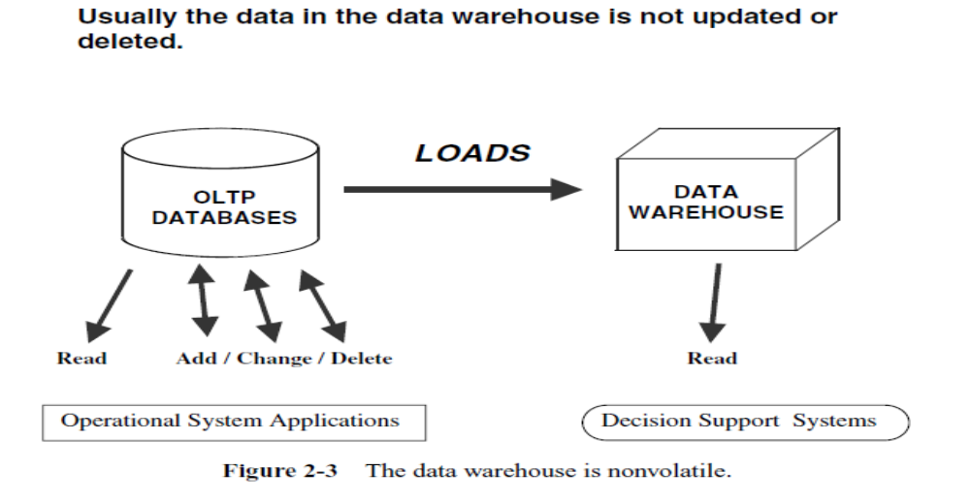
Nonvolatile Data
Data Warehousing

Slide 11
Validated
Data from various sources are validated before storing them in a data warehouse.
Data quality is crucial to the credibility of the warehouse
Data Warehousing

Slide 12
Data Granularity
Data granularity refers to the level of detail.
Depending on the requirements, multiple levels of detail may be present.
In Data Warehouse, the analysis begins at a high level and moves down to lower levels of detail.
Data Warehousing

Slide 13
Data Warehous
A data warehouse can be viewed as in information system the following attributes.
  It is a database designed for analytical tasks using data from multiple sources.
  Its supports a relatively small number of users with relatively long interactions.
  Its use is read-intensive.
  Its contents is periodically updated (mostly additions).
  It contains current and historical data to provide a historical perspective of information.
  It contains a few but large tables.
Data Warehousing

Slide 14
Data Warehousing
Technology required to plan, develop, manage, implement and use data warehouse.
At the heart of every data warehouse lie the large databases that store the integrated data of the enterprise, obtained both from internal and external sources.
Data Warehousing

Slide 15
Data Warehousing
Internal data
  Data that are extracted from the operational systems of the enterprise
External data
  Data provided by third party organizations including business partners, customers, government bodies etc.
Data Warehousing

Slide 16
Data Warehousing
Databases of operational systems which are often normalized to preserve and maintain data integrity
whereas
A data warehouse is designed and structured in a demoralized manner to support data warehouse.
The database is demoralized to mimic a business user’s dimensional view of the business
Data Warehousing

Slide 17
Data Warehousing
Every data warehouse have a time dimension.
Each data item (also called facts or measures) in the data warehouse is time-stamped to support queries or reports that requires the comparison of figures from prior months or years.
The time-stamping of each fact also makes it possible for decision makers to recognize trends and patterns in customers or market behavior over time.
Data Warehousing

Slide 18
Data Warehousing
Data warehouses holds data at different levels of detail.
Data at the most detailed level i.e. atomic level are used to derive the summarized aggregated values.
If the data warehouse stores data only at a summarized levels, its users will not be able to drill down on data items to get more detailed information.
Data Warehousing

Slide 19

Data Warehousing
A single, complete and consistent store of data obtained from a variety of different sources made available to end users in a what they can understand and use in a business context.
[Barry Devlin]
Data Warehousing

Slide 20
The purposes of data warehouse
To provide business users with access to data
  Access to integrated enterprise data is provided previously locked away in unfriendly, difficult to access environments
To provide one version of the truth
  The DW becomes the common information resource for decisional purpose throughout the organization.
  The data in DW are consistent and quality assured before being released to business users.
Data Warehousing

Slide 21
The purposes of data warehouse
To record the past accurately
  Historical data are loaded and integrated with other data in the DW for quick access
  Many of the figures and numbers that managers receives have little meaning unless compared with historical figures.
  A DW is used to record the past accurately, leaving the OLTP systems free to focus on recording current transactions and balances.
Data Warehousing

Slide 22
The purposes of data warehouse
To slice and dice through data
  Dynamic reports allow users to view warehouse data from different angles, at different levels of detail.
  The ready availability of different data views also improves business analysis by reducing the time and effort required to collect, format and distill information from data
Data Warehousing

Slide 23
The purposes of data warehouse
To separate analytical and operational processing
  Decisional information processing and operational information processing have totally divergent architectural requirements.
  Combining both in a same system architecture merely increase complexity and will create system maintenance nightmares.
Data Warehousing

